Slide 1
Introduction DevOps
DevOps - The Future of Application
Lifecycle Automation

Slide 2
Agenda
What is DevOps?
Why DevOps?
Addressing Delivery Challenges?

Slide 3
About DevOps
a software development method that stresses communication, collaboration and integration between software developers and information technology (IT) professionals.
In simple terms, DevOps refers to an umbrella concept that encompasses people, processes, and technologies required to connect development to execution.

Slide 4
Why DevOps
From Developer to Operations – One and the Same?
Infrastructure Automation
Growing Pains
– How do you provision virtual machines?
– How do you configure network devices and servers?
– How do you deploy applications?
– How do you collect and aggregate logs?
– How do you monitor services?
– How do you monitor network performance?
– How do you monitor application performance?
–

Slide 5
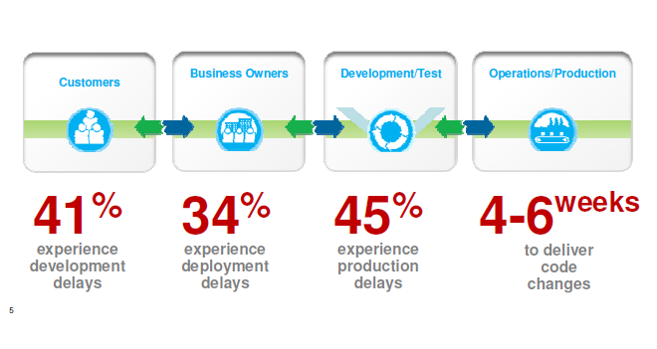
Why DevOps

Slide 6
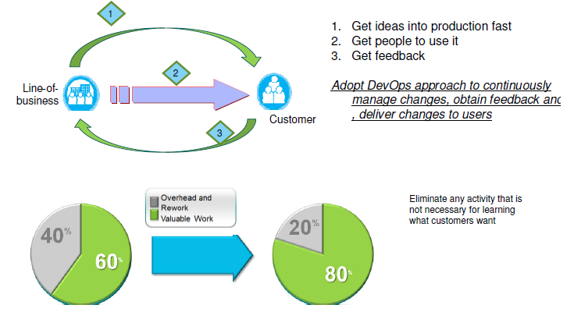
DevOps – Needs

Slide 7
DevOps – Needs
DevOps applies agile and lean principles across the entire software supply chain
It enables a business to maximize the speed of its delivery of a product or service, from initial idea to production release to customer feedback to enhancements based on that feedback.

Slide 8
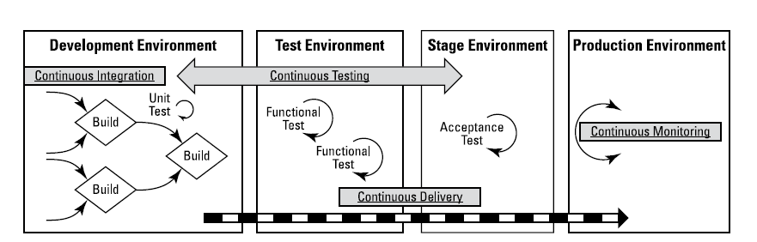
DevOps – Needs –Continues ….

Slide 9
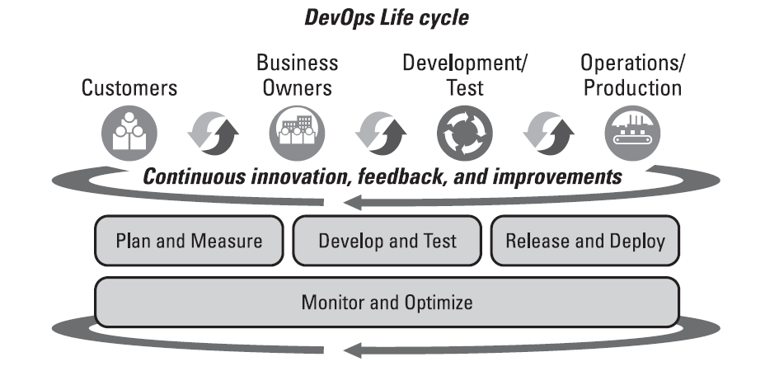
DevOps Life Cycle

Slide 10
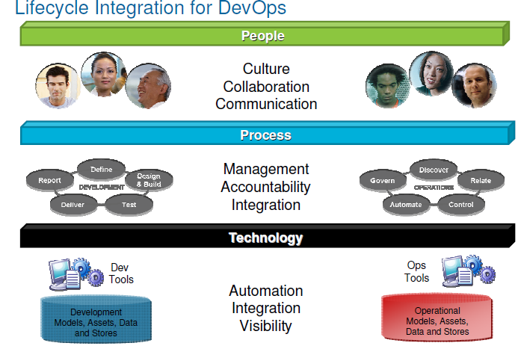
DevOps –Lifecycle integration

Slide 11
DevOps –Capabilities
Plan and measure
Develop and test
Release and deploy
Monitor and optimize

Slide 12
DevOps – Plan and measure
This adoption path consists of one practice that focuses on the lines of business and their planning processes
Businesses need to be agile and able to react quickly to customer feedback. Consequently, many businesses today employ lean thinking techniques

Slide 13
DevOps – Develop and Test
This adoption path involves two practices: collaborative development and continuous testing.
Continuous integration was made popular by the agile movement. The idea is for developers to regularly integrate their work with that of the rest of the developers on their team and then test the integrated work.
Enable ongoing testing and verification of code and Continuously test the application being developed

Slide 14
DevOps – Release and Deploy
Release and deploy forms the adoption path where most of the root capabilities of DevOps originated
Continuous release and deployment take the concept of continuous integration to the next step.
The goal of continuous release and deployment is to release new features to customers and users as soon as possible.

Slide 15
DevOps – Monitor and Optimize
Continuous monitoring provides data and metrics to Operations, QA, Development, lines-of-business personnel, and other stakeholders about applications at different stages of the delivery cycle.
The monitor and optimize adoption path includes two practices that allow businesses to monitor how released applications are performing in production and to receive feedback from customers. This data allows the businesses to react in an agile manner and change their business plans as necessary.

Slide 16
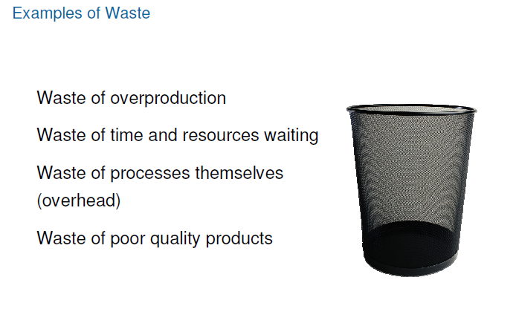
DevOps –

Slide 17
DevOps - tools
Configuration Management | Deployment Automation | Log Management | Performance Management | Monitoring
Chef | Jenkins | Splunk | AppDynamics | Nagios
Puppet | Octopus | Loggly | Boundary | Ganglia
Ansible | Docker | LogStash | Cloudweaver | Icinga
 | Bamboo (Build, Test, Deploy and Connect )

Slide 18
DevOps – tools
Build :Focus on coding and count on Bamboo as your CI and build server! Create multi-stage build plans, set up triggers to start builds upon commits, and assign agents to your critical builds and deployments
Test Testing is a key part of continuous integration. Run automated tests in Bamboo to regress your products thoroughly with each change. Parallel automated tests unleash the power of Agile Development and make catching bugs easier and faster.
Deploy Bamboo offers first-class support for the "delivery" aspect of continuous delivery. Deployment projects automate the tedium right out of releasing into each environment, while letting you control the flow with per-environment permissions.
Connect Bamboo boasts the best integration with JIRA Software, Bitbucket,Fisheye, and HipChat. Also, boost your CI pipeline by choosing from more than a hundred fifty add-ons in our Marketplace or make your own!

Slide 19
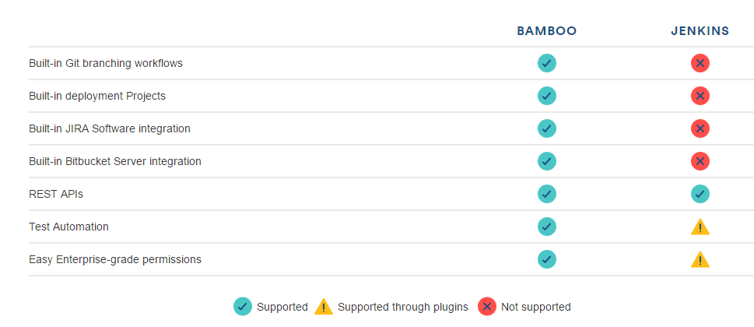
DevOps – Tools

Slide 20
DevOps – Tools
Continuous Integration (CI) – Developers integrate code into a shared repository multiple times a day and each isolated change to the code is tested immediately in order to detect and prevent integration problems.
Examples of vendors and tools: Jenkins, Teamcity, TravisCI, CircleCI
Continuous Delivery (CD) – As an extension of CI and the next step in incremental software delivery, continuous delivery (CD) ensures that every version of the code that is tested in the CI repository can be released at any moment.
Examples of vendors and tools: Jenkins, Teamcity, TravisCI, Electric Cloud, Go, Codeship, AWS CodeDeploy

Slide 21
DevOps –
Configuration Management (CM) In a nutshell, the process of maintaining up-to-date, detailed records of hardware and software — including versions, requirements, network addresses, and design and operational information — is known as configuration management (CM). You can use CM tools such as Chef, Puppet, or Ansible to aid the process. You can also use Bash and Python to build your own configuration management automation
Examples of vendors and tools: Chef, Puppet, Ansible, Saltstack, Vagrant, CFEngine
Containers : docker square logoLinux containers are lightweight virtualization components that run isolated application workloads. They run their own processes, file systems, and network stacks, which are all virtualized using the root operating system (OS) running on the hardware.
Examples of vendors and related tools: Docker, CoreOs, Kubernetes, Mesos, ElasticBox

Slide 22
DevOps –
Source (Version) Control : Version control includes practices and tools that help R&D organizations maintain and control changes within their source code repository. R&D members use source control tools to document and track system configuration files as well.
Examples of vendors and tools: TFS, SVN, GitHub, Bitbucket, JFrog, Artifactory
Bug Tracking : github logoA bug tracker is a system that aggregates and reports software bugs and defects. It helps R&D organizations with task management and is part of the consistent feedback loop that the DevOps methodology requires.
Examples of vendors and tools: BUGtrack, JIRA, GitHub
Test Automation Test automation facilitates test engineer work by supporting multiple tests that run continuously. It enhances test coverage while supporting efficient release cycles. For example, test automation tools help manage, execute, and measure functional tests and load tests.
Examples of vendors and tools: Selenium, Cucumber, JUnit, TestNG, JMeter

Slide 23
DevOps –
Monitoring Monitoring is a primary element of IT performance management and is one of the most important aspects when operating online services. Monitoring tools are essential and provide crucial information that helps to ensure service robustness in terms of availability, security, and performance.
Application Performance Monitoring (APM) – APM allows you to automatically detect and be alerted about hotspots in your application framework that include the application and database layers.
Examples of vendors and tools: New Relic, AppDynamics, DataDog
Infrastructure Monitoring – Tools in this category automatically detect and alert about degradations in underlying physical or virtual resource performance and availability.
Examples of vendors and tools: AWS CloudWatch, Nagios, Zabbix, Sensu, Icynga

Slide 24
DevOps –
Log Management : Log management (or log analytics) is the practice of dealing with large volumes of computer-generated messages. They can be operational messages (e.g., when tracking service performance or security) or for BI purposes (e.g., when tracking online user behavior
Vendors and tools: Logz.io (ELK), Splunk, Sumo Logic

Slide 25
DevOps – Books
Continuous Delivery: Reliable Software Releases through Build, Test, and Deployment Automation (Addison-Wesley Signature Series (Fowler)
The DevOps 2.0 Toolkit

Slide 26
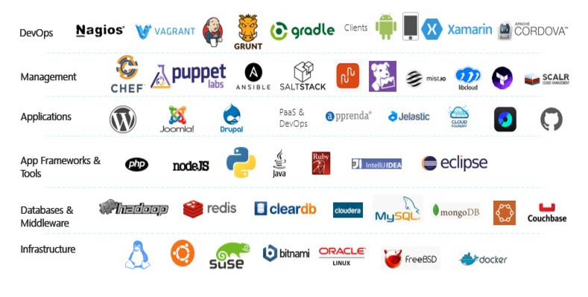
DevOps –

Slide 27
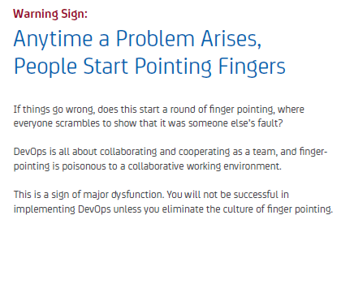
DevOps –Needs ..

Slide 28
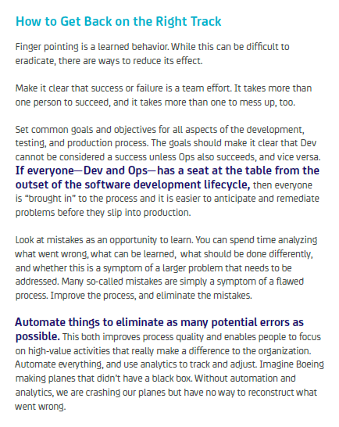
DevOps –Needs ..

Slide 29
DevOps - TFS
Configuration Management | Deployment Automation | Log Management | Performance Management | Monitoring
No | Jenkins | Splunk | AppDynamics | Nagios
Config Mgmt | Source Control | Continuous Integration | Deploy Automation | Log Management | Monitoring
No | Yes | Yes | Yes
NA | OOB | OOB | OOB | No | Using SCOM Management Pack

